Slide 1
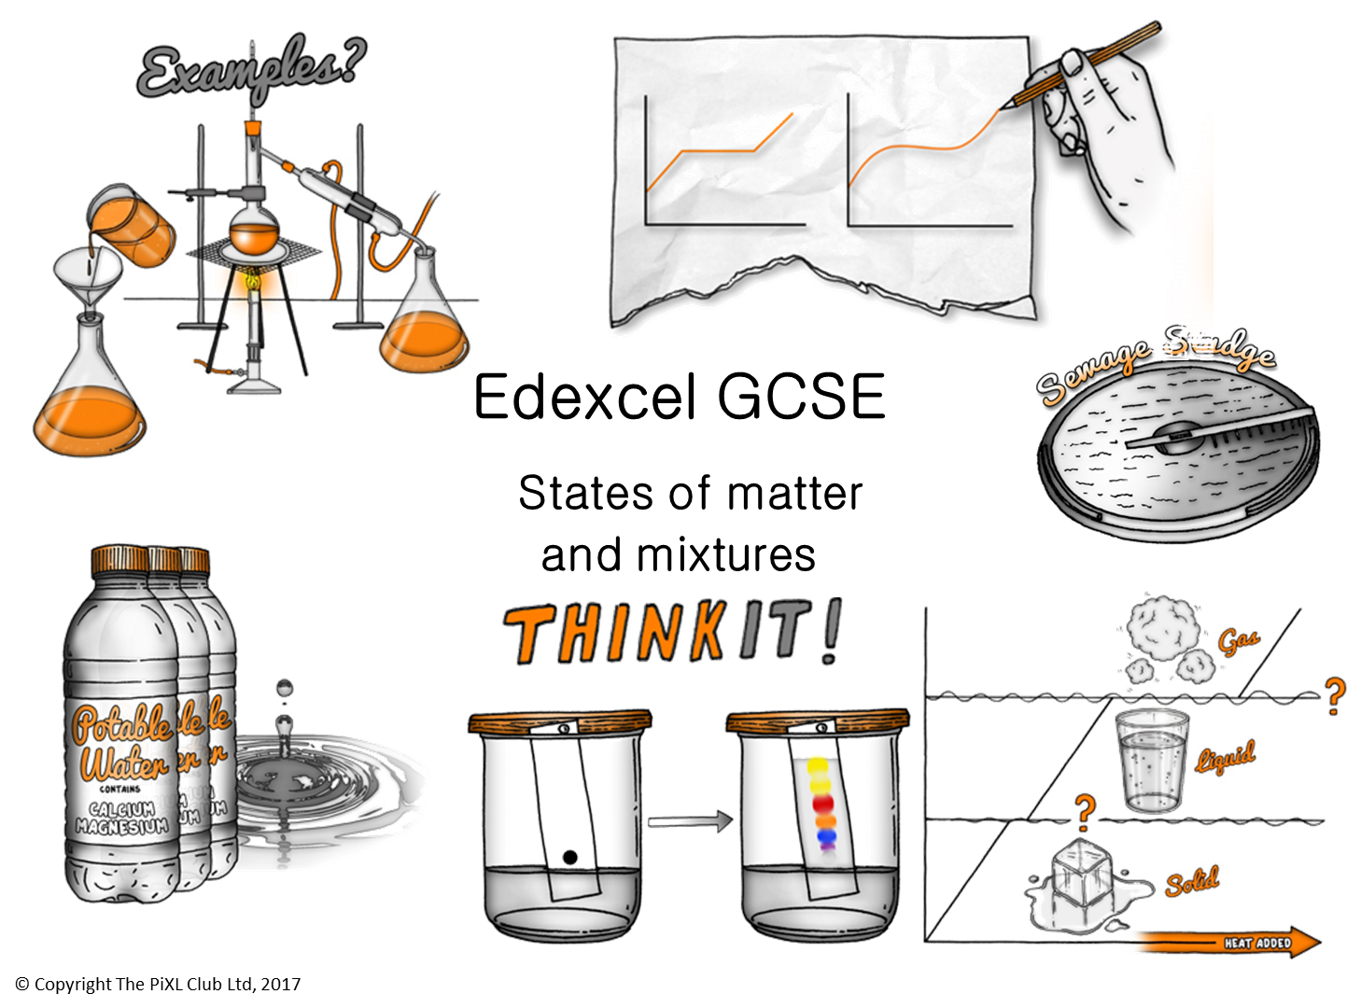

Slide 2
States of matter:
Describe the three states of matter using the particle model. In extreme environments plasma may be present, describe this state.
Sublimation is a change in state between solids and gases. Using the particle theory, explain the changes taking place during sublimation.
During changes in state the temperature of the substance does not change. Explain why; what is this energy being used for?
Pure substances:
Sea water is not a pure substance. Explain why sea water cannot be described as pure
Draw graphs to compare the boiling points of pure water and sea water and explain what these graphs show.
Soap is often described as pure, would you agree with this statement? Explain your answer.
Changes in State:
Ammonia is a liquid between -77.7 °C and -33.3°C. Use the kinetic theory to explain the three states of matter in this case.
Using the particle theory, predict how temperature and pressure affect the density of a fixed mass of gas.
HT only - Explain the limitations of the particle theory.
Chromatography:
Chromatography is carried out on three pure substances: A has an Rf value of 0.7, B has an Rf value of 0.4, C has an Rf value of 0. What can you conclude from this?
Explain how paper chromatography separates mixtures.
Describe how you could use chromatography to separate a pure substance from a mixture of three pure substances.
Edexcel GCSE States of matter and mixtures
ThinkIT!
Potable water and waste water treatment:
Explain why potable water is not described as pure water.
Describe the two different processes that can be used to produce potable water form salty water.
Waste water is treated in sewage works. What are the implications for humans and the environment if all the sewage work stopped working?
© Copyright The PiXL Club Ltd, 2017
Mixtures:
Fizzy drinks are a mixture of several compounds including water, sugar, carbon dioxide. Describe the methods used to separate these compounds from the mixture.
Air is a mixture of gases. Suggest how these gases could be separated using your knowledge of kinetic theory.
Food scientists can identify the different colours in food colouring. Describe and explain how. You can use a diagram.
:
Mixtures:
A mixture of salt water and sand needs to be separated into its three separate components. For each component describe the method used to separate it. Draw a diagram of the equipment.
Crude oil can be separated using fractional distillation. Describe how this process works.
Predicting the state of matter:
Hexane has a melting point of -95ºC and a boiling point of 69ºC. What state would this be at 20ºC.
Hydrogen chloride has a melting point of -112ºC and a boiling point of -85ºC. What state would this be at 25ºC?

